Slide 1
Timer / RTC/ WatchDog

Slide 2
Outline
SampleCode Projects to cover:
TMR_LED
TMR_Modes
TMR_EventCount
RTC_LCD
RTC_Alarm
RTC_LCD_Clock
WDT_Interrupt
WDT_Reset
2

Slide 3
Timer
Many embedded applications require a microcontroller to operate at a different clock frequency depending on the mode of operation.
Usually, the microcontroller is required to
generate accurate timing intervals
time/count external events (timer as an input device)
generate digital signals of desired frequency and pulse duration (timer as an output device, such as in PWM).
3

Slide 4
Timer
Overview
The timer controller includes four 32-bit timers, TIMER0~TIMER3
The timer can perform functions like frequency measurement, event counting, interval measurement, clock generation, delay timing and so on.
The timer can generate an interrupt signal upon timeout, or provide the current value during operation.
Features
4 sets of 32-bit timers, each with a 24-bit up-timer and one 8-bit prescaler counter (divider)
Provides one-shot, periodic, toggle and continuous counting operation modes
Supports event counting function to count the event from external pin
Selectable 5 clock source
Time out period = (Period of timer clock input) * (8-bit prescale + 1) * (24-bit TCMP)
4

Slide 5
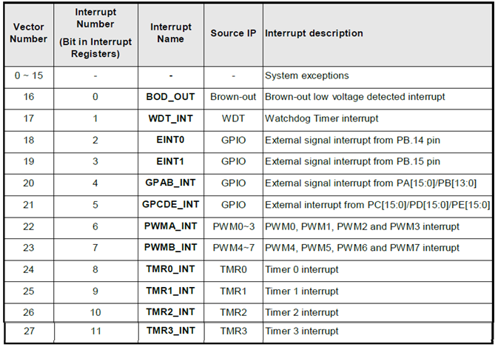
NUC140 System Interrupt Map
5

Slide 6
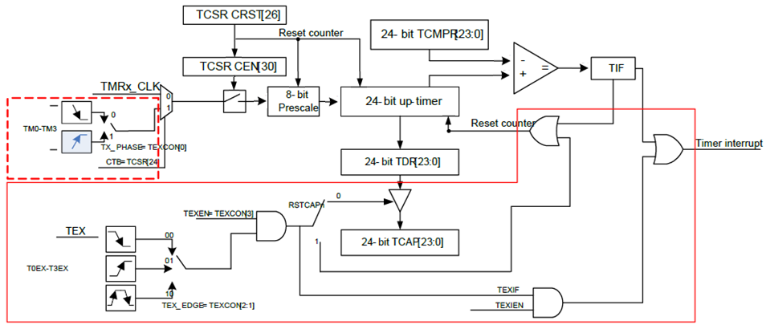
NUC140 Timer Block Diagram
Each channel is equipped with an 8-bit pre-scale counter, a 24-bit up-timer, a 24-bit compare register, and an interrupt request signal.
Software can program the 8-bit pre-scale counter to decide the clock period to 24-bit up timer.
6

Slide 7
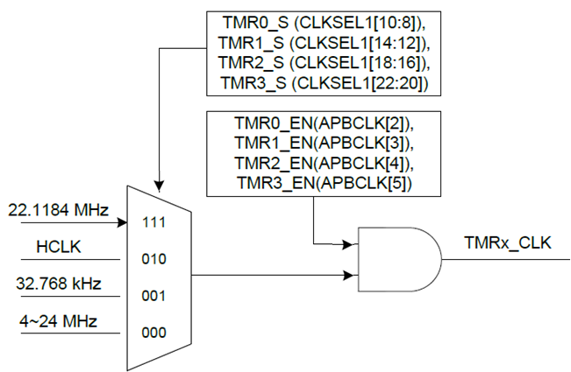
Timer Clock Source
There are four options of clock sources for each channel.
In clock controller
In clock controller
internal high speed oscillator
external low speed crystal
external high speed crystal
7

Slide 8
Example
Set TCMPR = 100
One-Shot mode
Periodic mode / Toggle mode
Continuous Counting mode
Interrupt
One shot
0
100
Reset counter
Periodic
0
100
Overflow
Continuous
0
100
101
2²⁴-1
8

Slide 9
Functional Description
One-shot Mode
If CEN (TCSR[30] timer enable bit) is set to 1, the timer counter starts up counting
Once the timer counter value reaches timer compare register (TCMPR) value
if IE (TCSR[29] interrupt enable bit) is set to 1, then the timer interrupt flag is set and the interrupt signal is generated and sent to NVIC to inform CPU.
If IE (TCSR[29] interrupt enable bit) is set to 0, no interrupt signal is generated.
Once the timer counter value reaches timer compare register (TCMPR) value, the timer counter value goes back to counting initial value and CEN (timer enable bit) is cleared to 0 by timer controller. The timer counting operation also stops.
Periodic Mode
If CEN (TCSR[30] timer enable bit) is set to 1, the timer counter starts up counting
Once the timer counter value reaches timer compare register (TCMPR) value
if IE (TCSR[29] interrupt enable bit) is set to 1, then the timer interrupt flag is set and the interrupt signal is generated and sent to NVIC to inform CPU.
If IE (TCSR[29] interrupt enable bit) is set to 0, no interrupt signal is generated.
Once the timer counter value reaches timer compare register (TCMPR) value, the timer counter value goes back to counting initial value and CEN (timer enable bit) is kept at 1 (counting enable continuously). The timer operates up counting again.
9

Slide 10
Functional Description
Toggle Mode
If CEN (TCSR[30] timer enable bit) is set to 1, the timer counter starts up counting
Once the timer counter value reaches timer compare register (TCMPR) value
if IE (TCSR[29] interrupt enable bit) is set to 1, then the timer interrupt flag is set and the interrupt signal is generated and sent to NVIC to inform CPU.
If IE (TCSR[29] interrupt enable bit) is set to 0, no interrupt signal is generated.
The associated toggle output (tout) signal is set to 1.
Once the timer counter value reaches timer compare register (TCMPR) value, the timer counter value goes back to counting initial value and CEN (timer enable bit) is kept at 1 (counting enable continuously). The timer operates up counting again.
If the interrupt flag is cleared by software, and IE (interrupt enable bit) is set to 1, then once the timer counter value reaches timer compare register (TCMPR) value, the timer interrupt flag is set and the associated toggle output (tout) signal is set to 0.
Thus, toggle output (tout) signal is changing back and forth with 50% duty cycle.
10

Slide 11
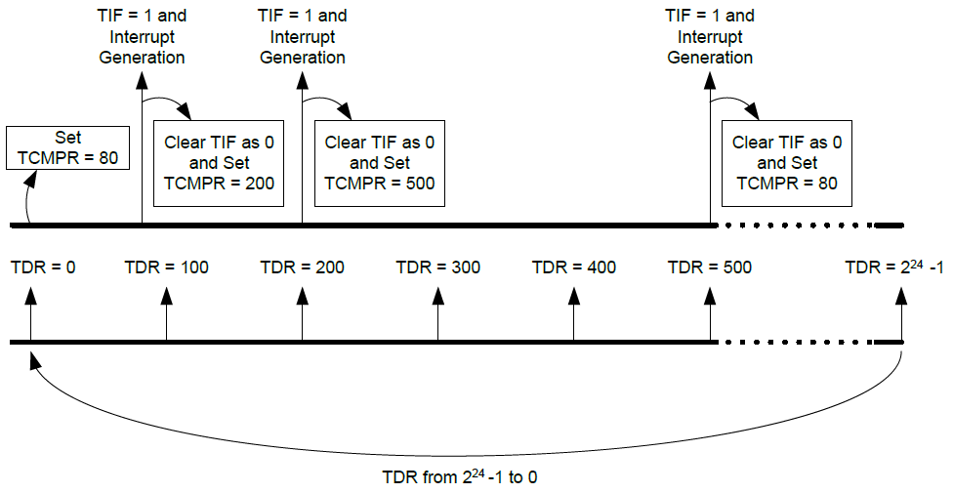
Functional Description
Continuous Counting Mode
If CEN (TCSR[30] timer enable bit) is set to 1, the timer counter starts up counting
The associated interrupt signal is generated depending on TDR = TCMPR if IE (TCSR[29] interrupt enable bit) is enabled.
User can change different TCMPR value immediately without disabling timer counting and restarting timer counting.
If CEN is kept at 1 (counting enable continuously) and TDR value will continue to count to 2²⁴ -1, 0, 1, 2, 3, ˙˙˙ to 2²⁴ -1 again and again.
11

Slide 12
Functional Description
Event Counting Function
An application which can count the event from TM0~TM3 pins is provided
It provides TM0~TM3 enabled or disabled de-bounce function by TEXCONx[7] and TM0~TM3 falling or rising phase counting setting by TEXCONx[0].
the event count source operating frequency should be less than 1/3 HCLK frequency if counting de-bounce is disabled or less than 1/8 HCLK frequency if counting de-bounce is enabled.
12

Slide 13
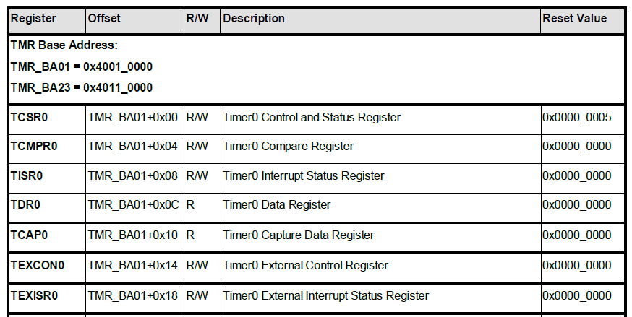
Timer Register Map
Timer0, Timer1
Timer2, Timer3
…….
(Timer1, Timer2, Timer3)
13

Slide 14
Timer Interrupt setting
Open Timer in specified mode and frequency
TIMER_Open(TIMER1, TMR1_OPERATING_MODE, TMR1_OPERATING_FREQ);
Enable Timer Interrupt:
TIMER_EnableInt(TIMER1);
Enable Timer IRQ:
NVIC_EnableIRQ(TMR1_IRQn);
Start Timer:
TIMER_Start(TIMER1);
14

Slide 15
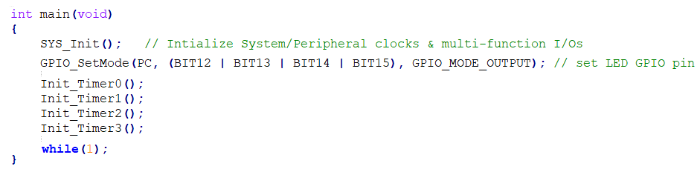
SampleCode: TMR_Modes
15

Slide 16
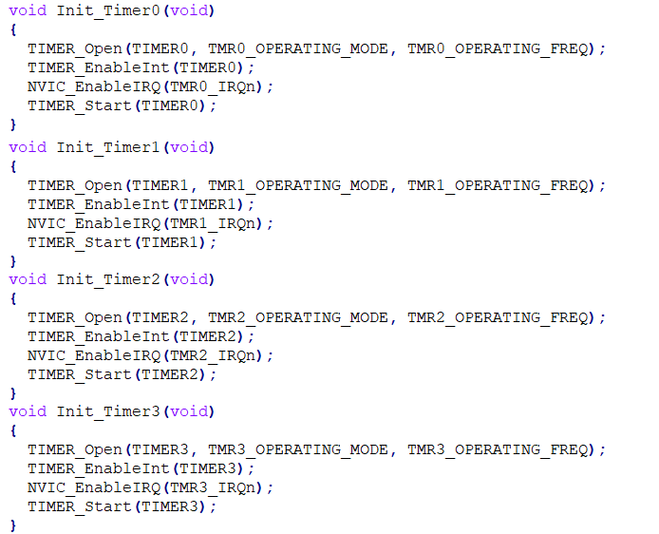
SampleCode: TMR_Modes
TIMER_ONESHOT_MODE
1
open 4 Timers at different mode with the same frequency 1Hz
TIMER_PERIODIC_MODE
1
TIMER_TOGGLE_MODE
1
TIMER_CONTINUOUS_MODE
1
16

Slide 17
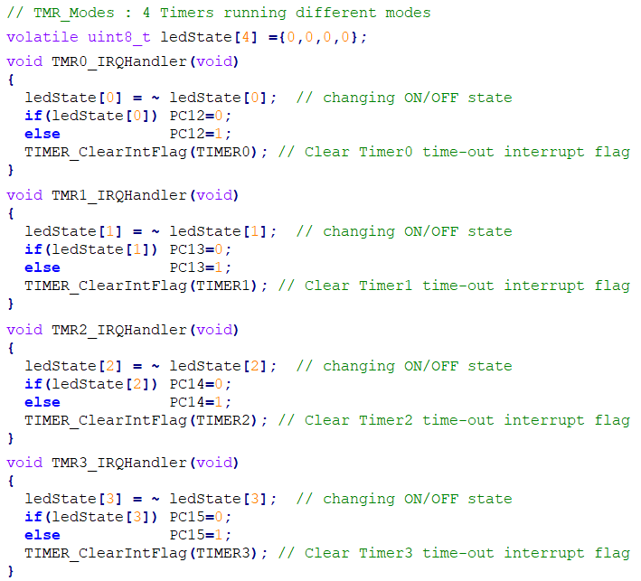
SampleCode: TMR_Modes
each Timer is set to different mode
and control 1 red LED
17

Slide 18
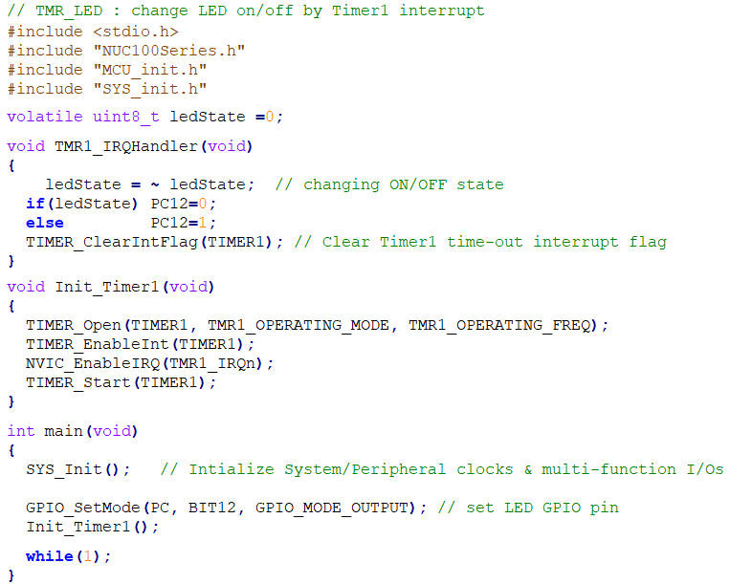
SampleCode: TMR_LED
TIMER_PERIODIC_MODE
1 Hz
18

Slide 19
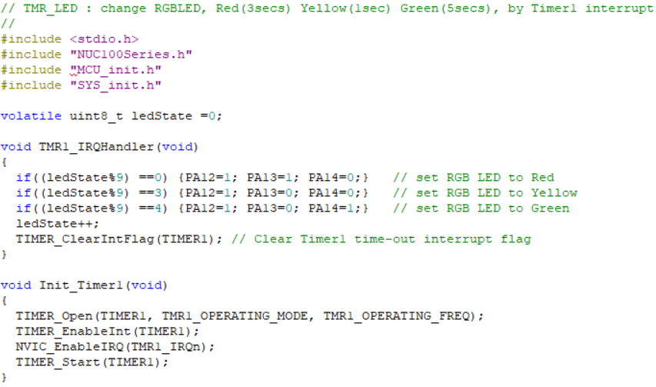
SampleCode: TMR_LED (RGB)
19

Slide 20
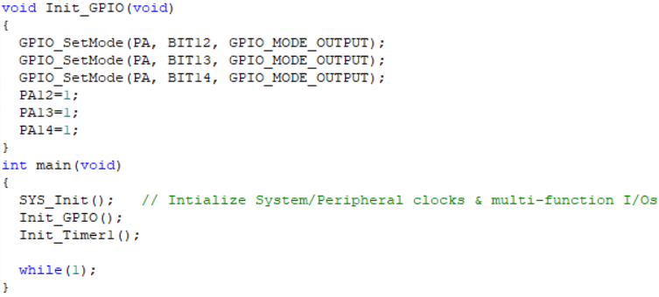
SampleCode: TMR_LED (RGB)
20

Slide 21
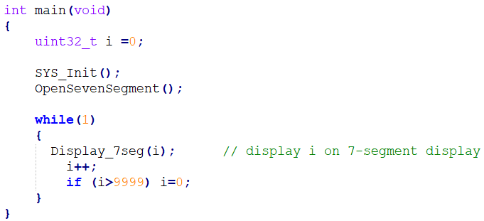
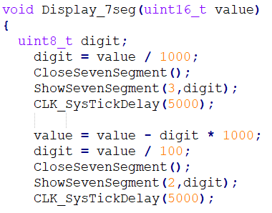
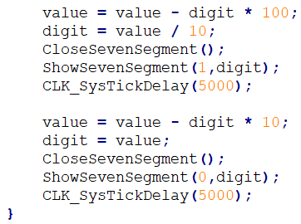
Review: GPIO_7seg
Delay 5ms
21

Slide 22
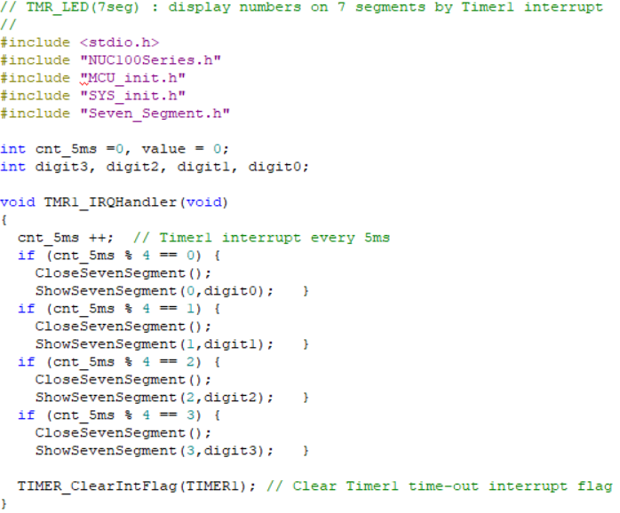
SampleCode: TMR_LED (7seg)
22

Slide 23
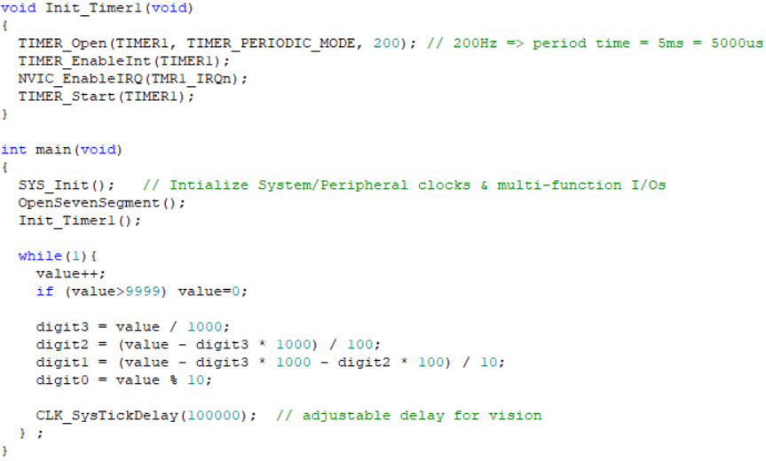
SampleCode: TMR_LED (7seg)
23

Slide 24
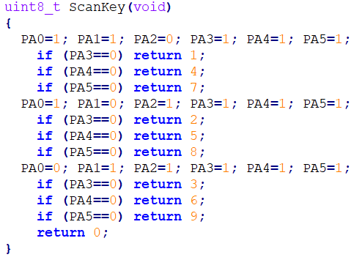
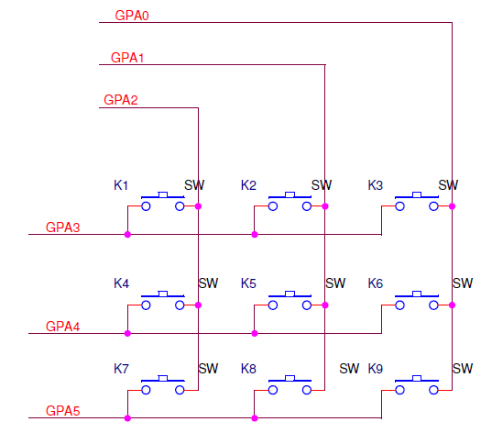
Review: Scankey.c
PA2, PA1, PA0 輪流設定為’0’
Key press will connect output pin to input pin
24

Slide 25
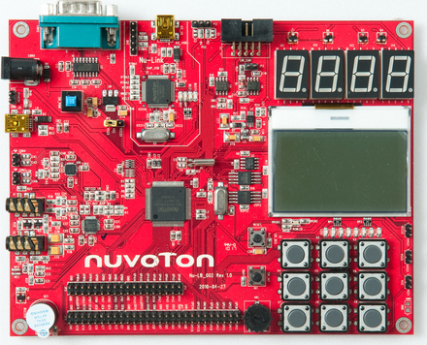
Review: GPIO_IRQ (with keypad)
GPAB_IRQn
0
0
0
25

Slide 26
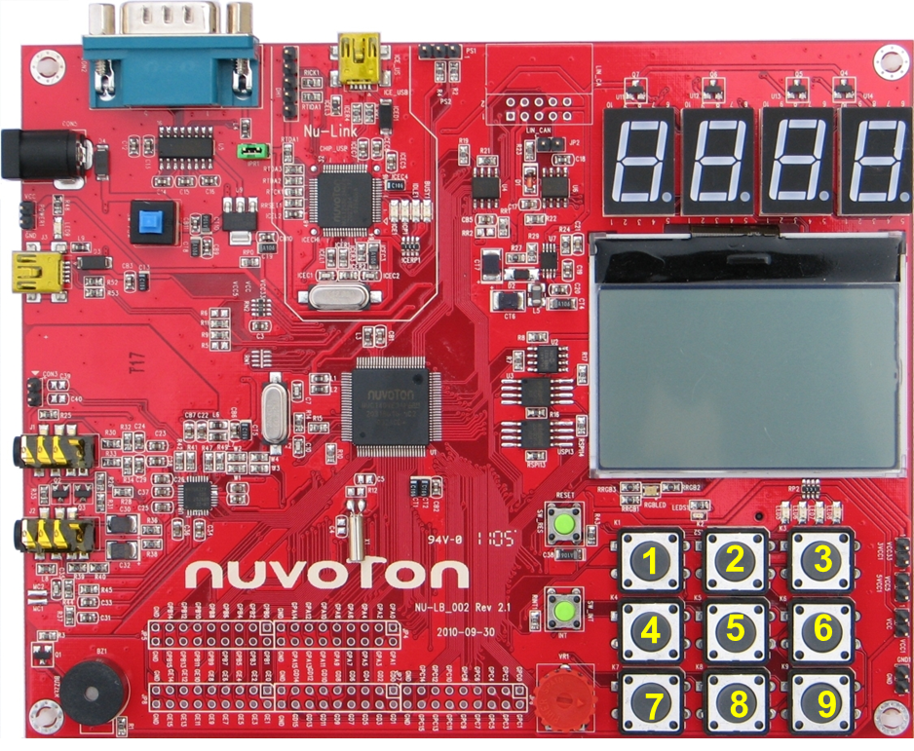
SampleCode: TMR_LED (7seg+keypad)1
GPAB_IRQn
0
1
1
1
0
1
1
1
0
26

Slide 27
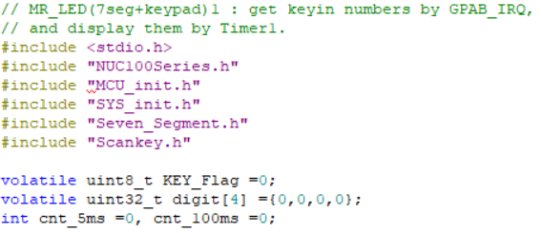
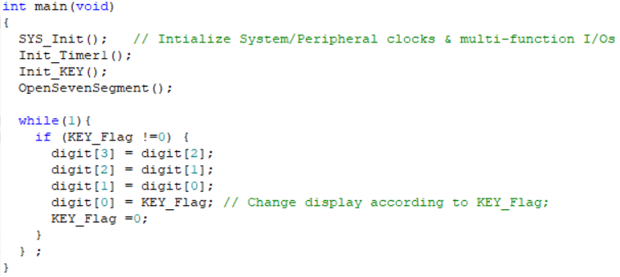
SampleCode: TMR_LED (7seg+keypad)1
27

Slide 28
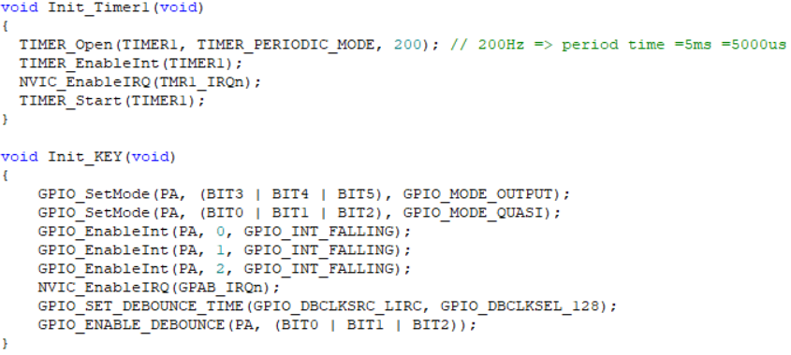
SampleCode: TMR_LED (7seg+keypad)1
28

Slide 29
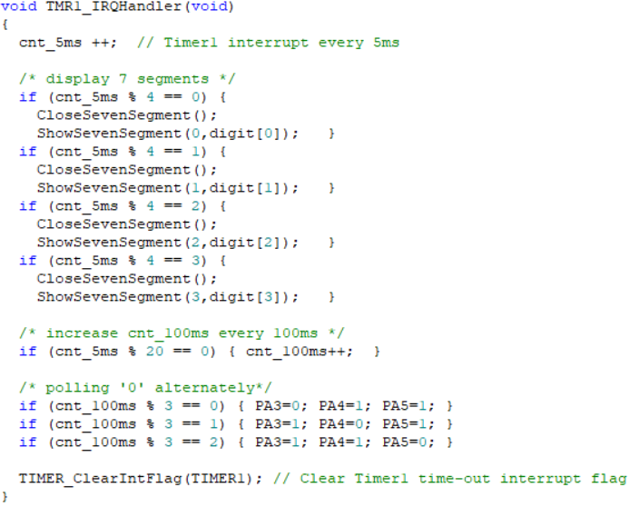
SampleCode: TMR_LED (7seg+keypad)1
29

Slide 30
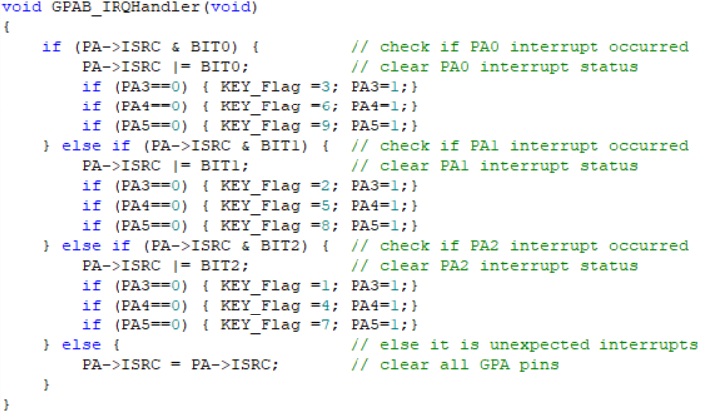
SampleCode: TMR_LED (7seg+keypad)1
30

Slide 31
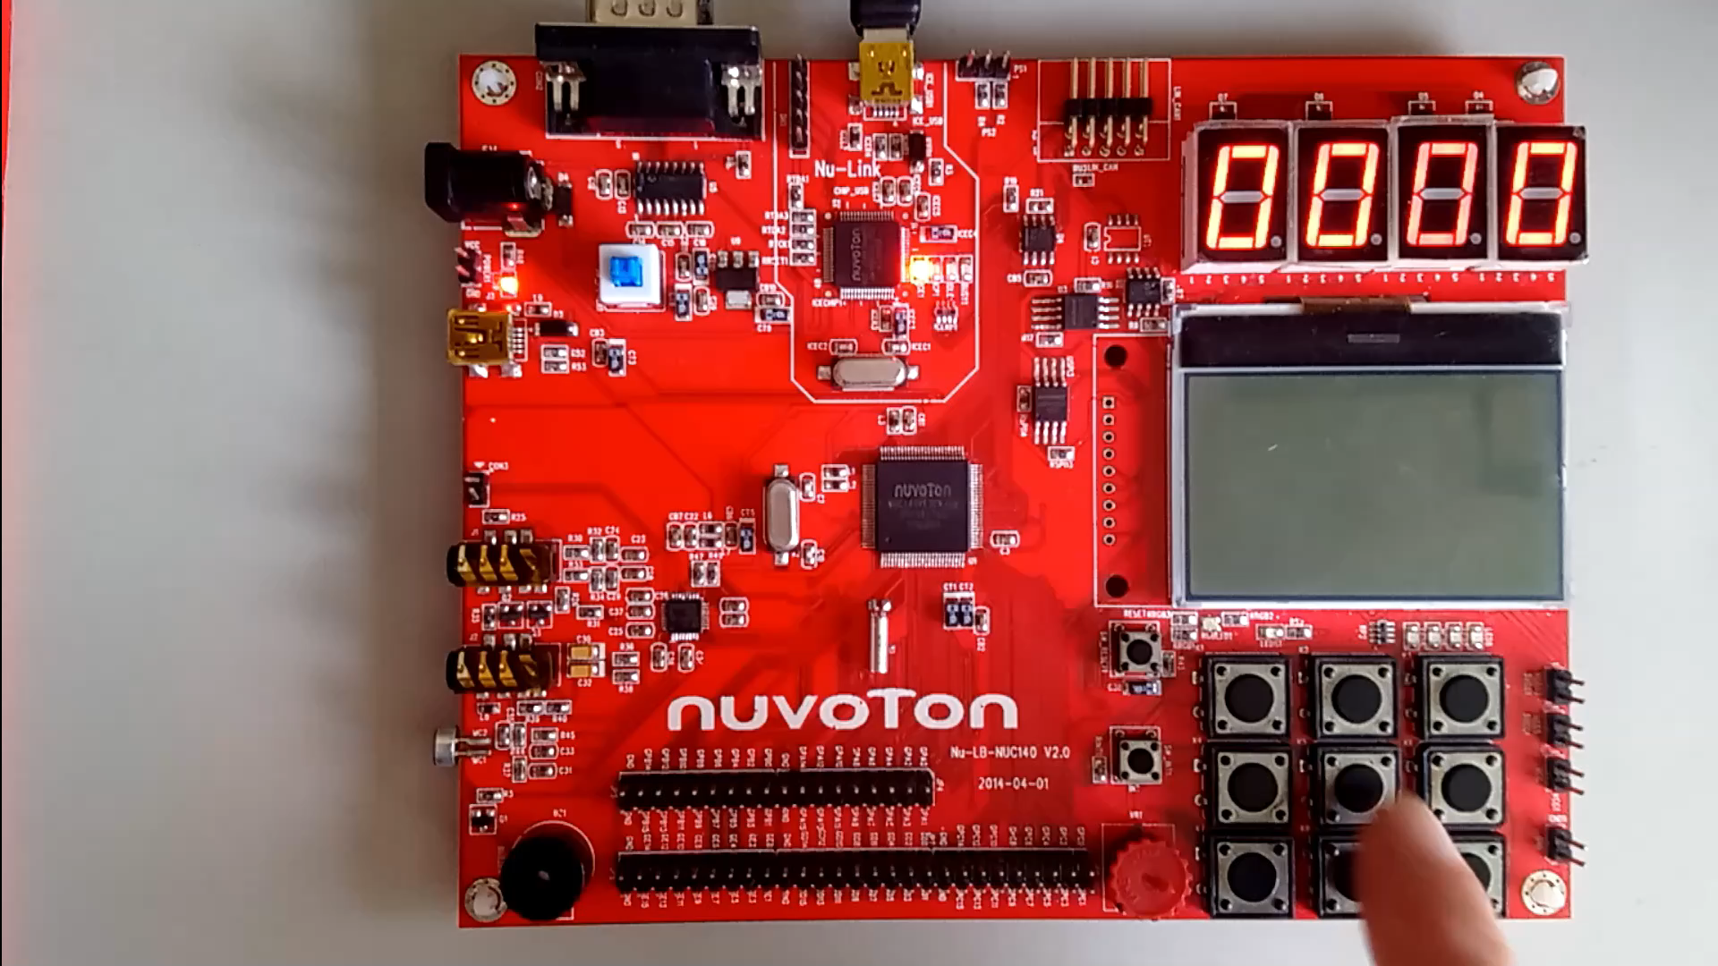
SampleCode: TMR_LED (7seg+keypad)1
31

Slide 32
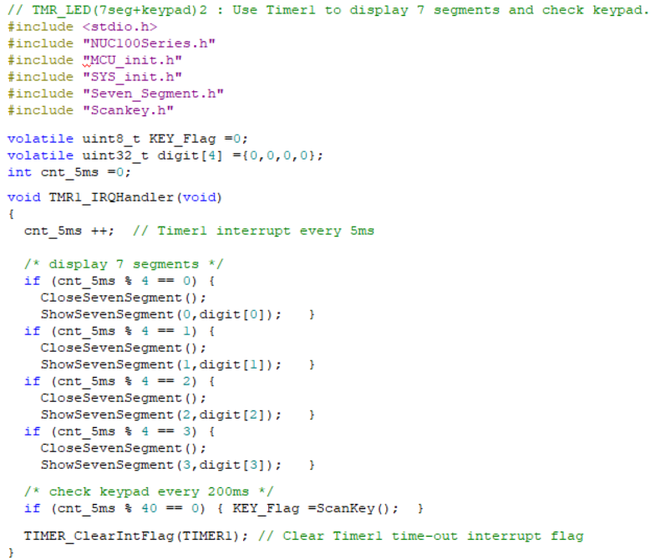
SampleCode: TMR_LED (7seg+keypad)2
32

Slide 33
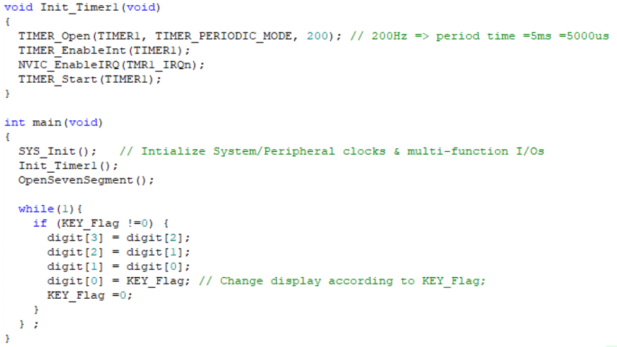
SampleCode: TMR_LED (7seg+keypad)2
33

Slide 34
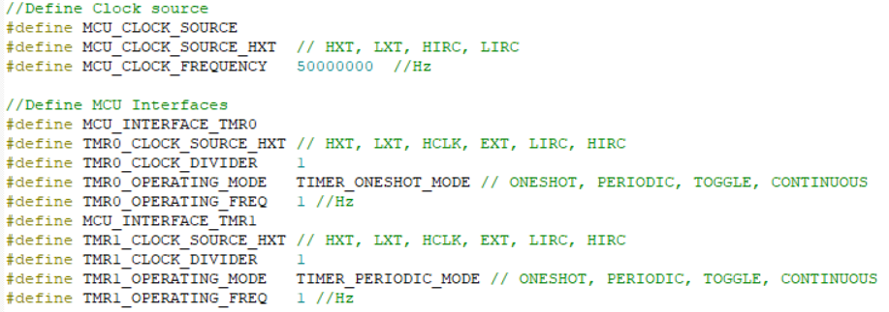
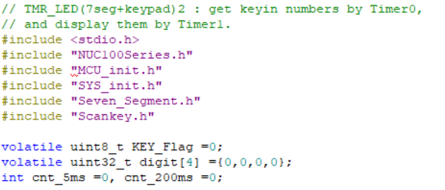
SampleCode: TMR_LED (7seg+keypad)3
MCU_init.h
3
34

Slide 35
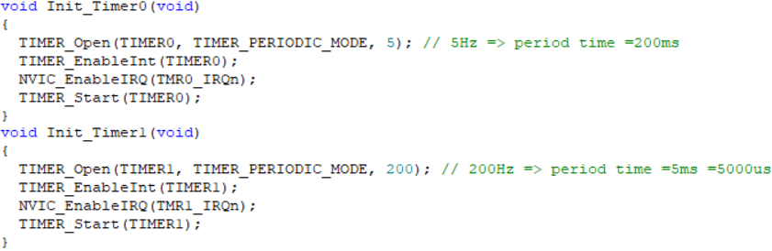
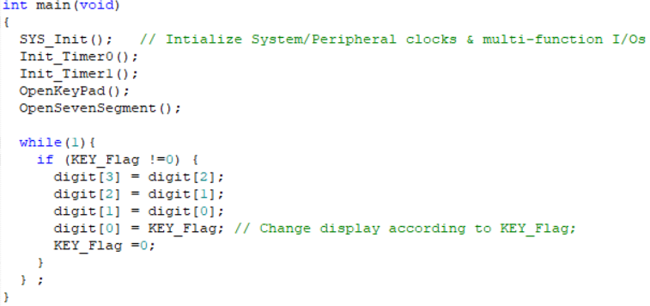
SampleCode: TMR_LED (7seg+keypad)3
35

Slide 36
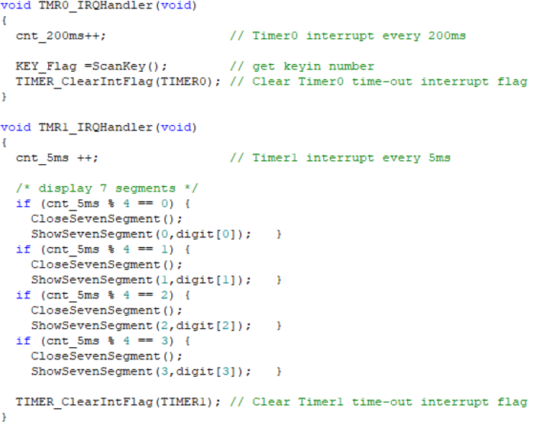
SampleCode: TMR_LED (7seg+keypad)3
36

Slide 37
Timer as Input Device
There are two possible choices for timer input signal.
One is to use an internal periodic clock signal, operating at known frequency, as timer input. This scenario has been discussed when the timer was used to generate periodic intervals.
Another is to use an external signal (either periodic or aperiodic but digital) as timer input using a GPIO pin configured for timer alternate functionality
When an external signal applied to the timer input is aperiodic, we might be interested in its accumulated count. The use of timer for this purpose is termed as external event counter.
When the external signal is periodic but of unknown frequency. The timer operating as an input capture device can be used to measure this unknown frequency of the external signal.
37

Slide 38
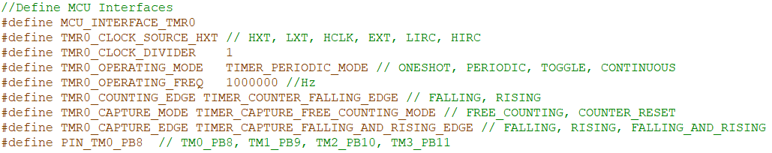
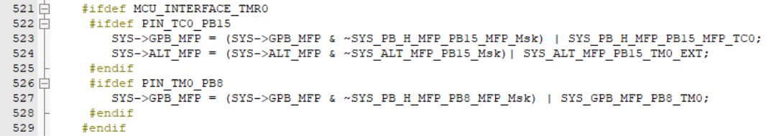
SampleCode: TMR_EventCount
MCU_init.h
SYS_init.c
Set PB8 as the Timer0 external input
38

Slide 39
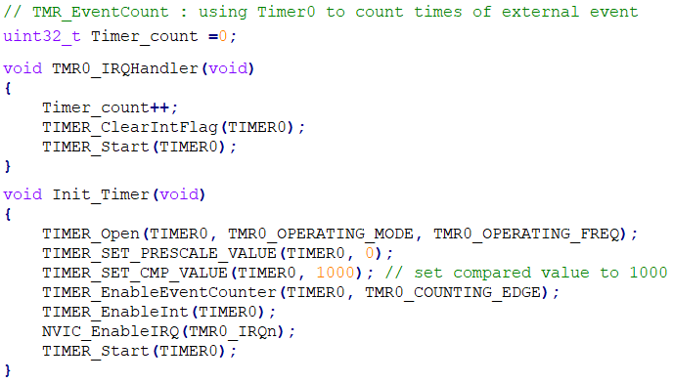
SampleCode: TMR_EventCount
TIMER_PERIODIC_MODE
39

Slide 40
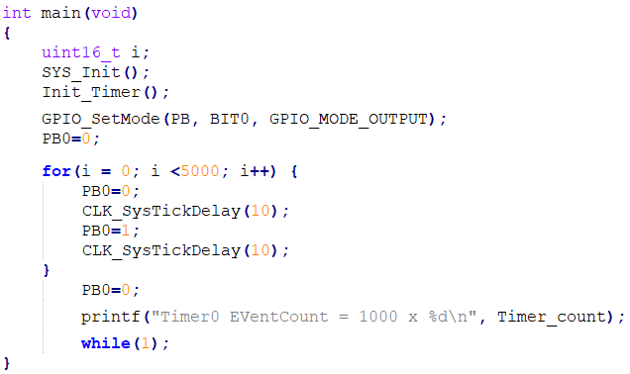
SampleCode: TMR_EventCount
Use a wire to connect PB8 and PB0,
such that the output of PB0 will be the input of PB8
40

Slide 41
Real Time Clock (RTC)
Overview
Real Time Clock (RTC) controller provides user the real time and calendar message.
RTC provides the time message (second, minute, hour) in Time Loading Register (TLR) as well as calendar message (day, month, year) in Calendar Loading Register (CLR).
Features
A time counter (second, minute, hour) and calendar counter (day, month, year) for user to check the time.
Alarm register (second, minute, hour, day, month, year).
12-hour or 24-hour mode is selectable.
Leap year compensation automatically
Support periodic time tick interrupt with 8 period options 1/128, 1/64, 1/32, 1/16, 1/8, 1/4, 1/2 and 1 second
Supports RTC Time Tick and Alarm match interrupt.
41

Slide 42
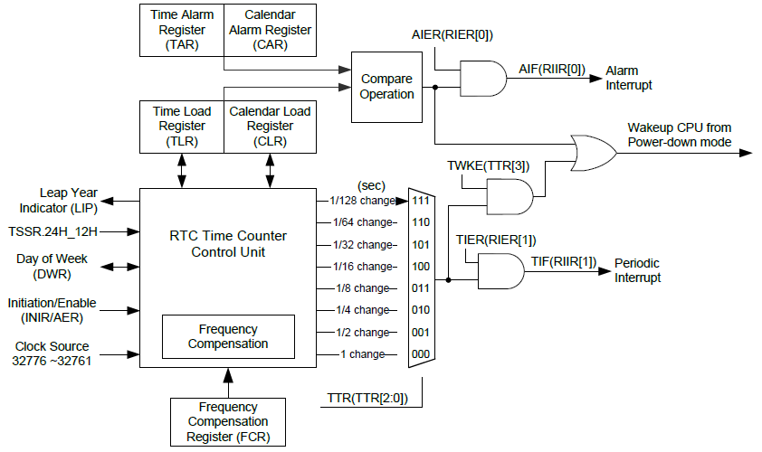
NUC140 Real Time Clock Block Diagram
42

Slide 43
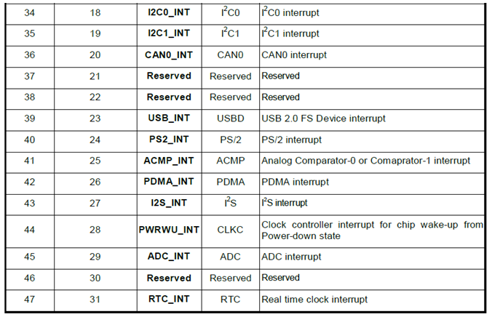
NUC140 System Interrupt Map
43

Slide 44
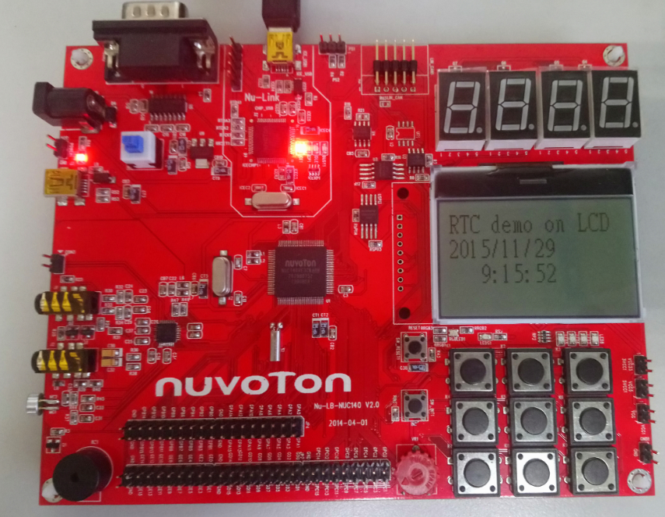
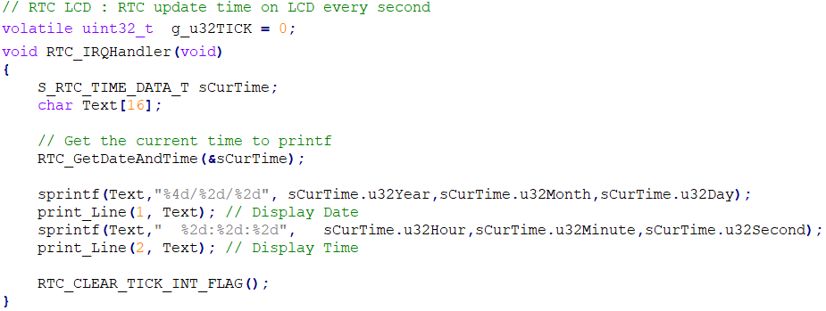
SampleCode: RTC_LCD
44

Slide 45
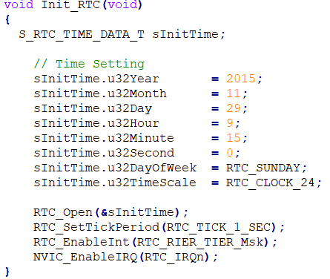
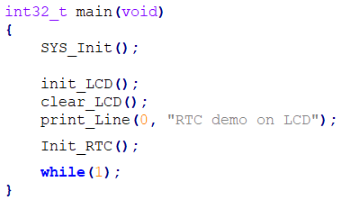
SampleCode: RTC_LCD
45

Slide 46
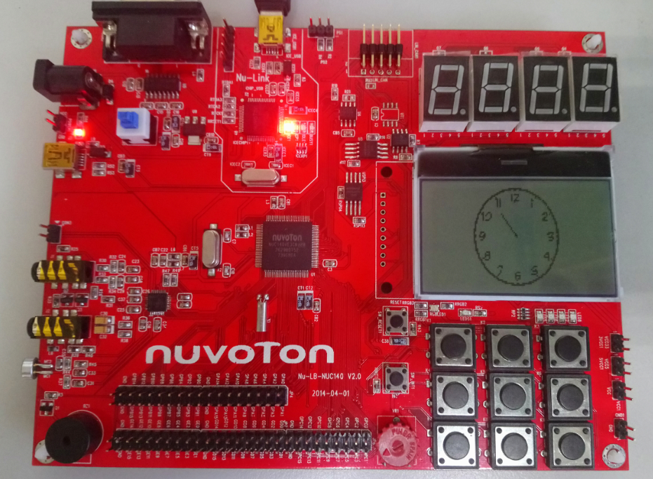
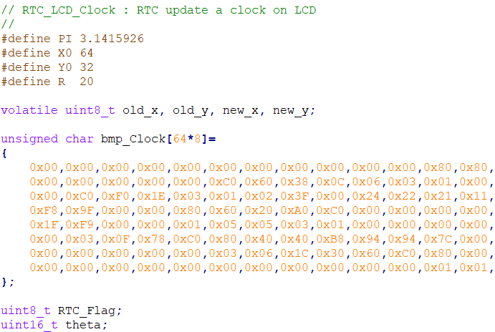
SampleCode: RTC_LCD_Clock
…………
46

Slide 47
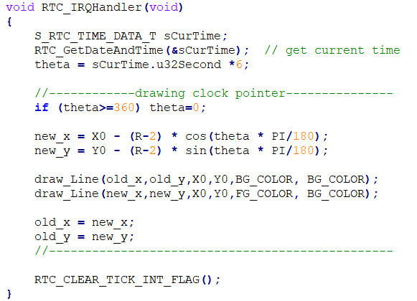
SampleCode: RTC_LCD_Clock
47

Slide 48
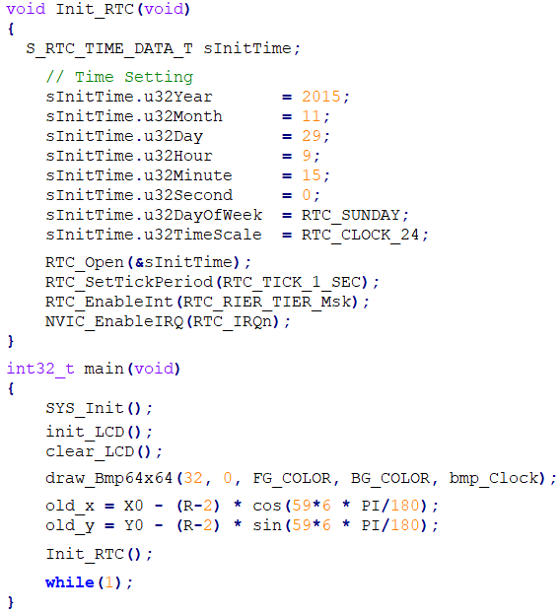
SampleCode: RTC_LCD_Clock
48

Slide 49
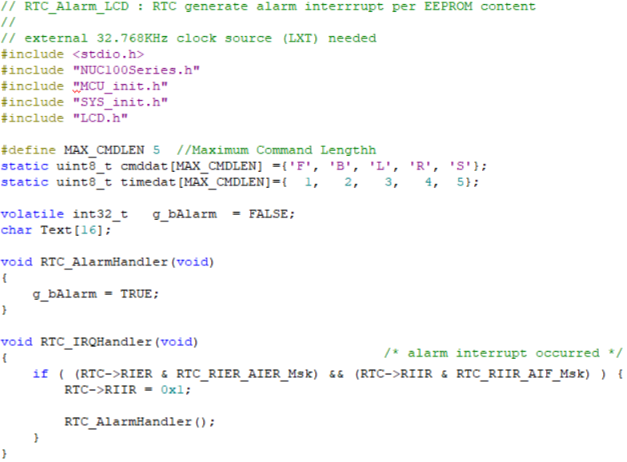
SampleCode: RTC_Alarm_LCD
49

Slide 50
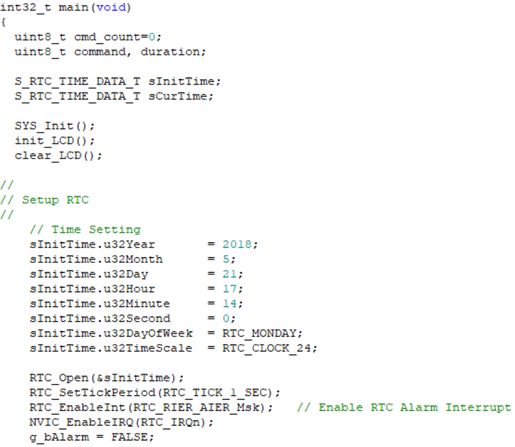
SampleCode: RTC_Alarm_LCD
50

Slide 51
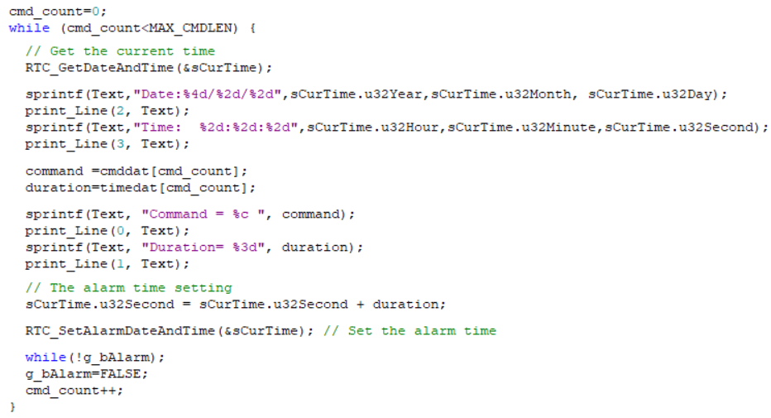

SampleCode: RTC_Alarm_LCD
51

Slide 52
Watchdog Timer (WDT) – Detecting Software “Hangs”
A common symptom of software problem – system hang
Could be an infinite loop.
Could be corrupted data.
… but often systems “lock up” or “hang”
Good general-purpose remedy – reboot system if it hangs
But, if there is no person around to press “ctl-alt-delete”
Let the watchdog timer do it instead
Basic watchdog idea:
Have a hardware timer running all the time
Software periodically “kicks” the watchdog, restarting the count
If software has “kicked” the watchdog often enough, no reset takes place
52

Slide 53

Watchdog General Block Diagram
System reset starts the watchdog initially
Kick restarts the watchdog
Watchdog resets CPU when it reaches timeout
Kick
53

Slide 54
Watchdog Timer (WDT)
Overview
The purpose of Watchdog Timer is to perform a system reset when system runs into an unknown state. This prevents system from hanging for an infinite period of time.
Support a function to wake-up chip from Power-down mode.
Features
An 18-bit free running counter with 8 programmable time-out intervals.
Selectable time-out interval (2^4 ~ 2^18) and the time out interval is 104 ms ~ 26.3168 s (if WDT_CLK = 10 kHz).
Reset period = (1 / 10 kHz) * 63, if WDT_CLK = 10 kHz.
Support function:
WDT interrupt
WDT reset
WDT wakeup
54

Slide 55

Watchdog Timer Clock Source
55

Slide 56


NUC140 Watchdog Timer Block Diagram
56

Slide 57

NUC140 System Interrupt Map
57

Slide 58

Timing of Interrupt and Reset Signal
58

Slide 59

Watchdog Timeout Interval Selection
If WDT_CLK = 10 kHz, then period T_{WDT} = 0.1ms
Timeout
Interrupt
2⁴ x0.1ms
=1.6ms
1024x0.1ms
=102.4ms
Minimum T_{WTR} = T_{TIS}
Maximum T_{WTR} = T_{TIS} + T_{INT}
59

Slide 60
Functional Description
Setting WTE (WDTCR [7]) enables the watchdog timer and the WDT counter starts counting up.
When the counter reaches the selected time-out interval, Watchdog timer interrupt flag WTIF will be set immediately to request a WDT interrupt if the watchdog timer interrupt enable bit WTIE is set
Meanwhile, a specified delay time (1024 * T_{WDT}) follows the time-out event.
User must set WTR (WDTCR [0]) (Watchdog timer reset) high to reset the 18-bit WDT counter to avoid chip from Watchdog timer reset before the delay time expires.
WTR bit is cleared automatically by hardware after WDT counter is reset.
There are eight time-out intervals with specific delay time which are selected by Watchdog timer interval select bits WTIS (WDTCR [10:8]).
If the WDT counter has not been cleared after the specific delay time expires, the watchdog timer will set Watchdog Timer Reset Flag (WTRF) high and reset chip.
This reset will last 63 WDT clocks (T_{RST}) then chip restarts executing program from reset vector (0x0000_0000).
WTRF will not be cleared by Watchdog reset. User may poll WTRF by software to recognize the reset source.
60

Slide 61
Functional Description
When chip is powered down and the Watchdog Timer Wake-up Function Enable bit WTWKE(WDTR[4]) is set, if the WDT counter reaches the specific time interval defined by WTIS (WDTCR [10:8]) , the chip is woken up from Power-down state.
An example:
When power down command is set by software, the chip enters Power-down state.
If WTIS is set to 000, the specific time interval for chip to wake up from Power-down state is 2⁴ * T_{WDT}. Then, after 2⁴ * T_{WDT} time is elapsed, chip is woken up from Power-down state.
Note that if WTRE is set to 1, after chip is woken up, software should clear the Watchdog Timer counter by setting WTR(WTCR [0]) to 1 as soon as possible.
Otherwise, after 1024 * T_{WDT} time is elapsed, the chip is reset by Watchdog Timer again.
61

Slide 62

Watchdog Timer Register Map
62

Slide 63

SampleCode: WDT_Interrupt
63

Slide 64

SampleCode: WDT_Interrupt
MCU_init.h
LIRC internal 10KHz RC clock
HIRC internal 22.1184MHz RC clock
LXT external X'tal 32.768KHz
64

Slide 65

SampleCode: WDT_Reset
After timeout Interval 2¹⁸ * T_{WDT}, the watchdog timer initiates an interrupt.
If user does not reset the watchdog timer, a system reset will be initiated after 1024 * T_{WDT} delay time.
65

Slide 66

SampleCode: WDT_Reset
66

Slide 67

SampleCode: WDT_Reset
MCU_init.h
WDT.h
WDT_CLEAR_RESET_FLAG() // Clear WDT Reset System Flag
WDT_CLEAR_TIMEOUT_INT_FLAG() // Clear WDT Time-out Interrupt Flag
WDT_CLEAR_TIMEOUT_WAKEUP_FLAG() // Clear WDT Wake-up Flag
WDT_GET_RESET_FLAG() // Get WDT Time-out Reset Flag
WDT_GET_TIMEOUT_INT_FLAG() // Get WDT Time-out Interrupt Flag
WDT_GET_TIMEOUT_WAKEUP_FLAG() // Get WDT Time-out Wake-up Flag
WDT_RESET_COUNTER() // Reset WDT Counter
WDT_Close(void) // Stop WDT Counting
WDT_EnableInt(void) // Enable WDT Time-out Interrupt
WDT_DisableInt(void) // Disable WDT Time-out Interrupt
67

Slide 68

SampleCode: WDT_Reset (clear WDT)
Clear the watchdog timer before the timer initiates a system reset
68

Slide 69

SampleCode: WDT_Wakeup
69

Slide 70

SampleCode: WDT_Wakeup
70

